Slide 1


Slide 2
Simplicity Series
The 1st Fuel-Convertible
Concentric Vent
Non-Condensing Tankless Series

Slide 3
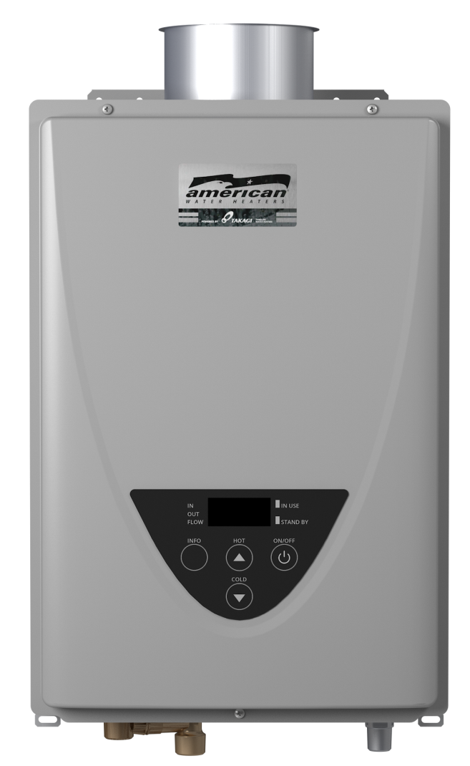
Agenda
Features and Benefits
Gas Conversion
Venting
Summary

Slide 4
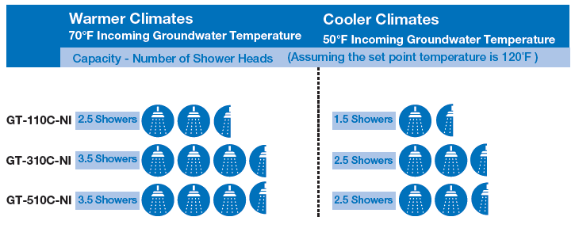
Features & Benefits
Wide range of btu/h inputs to cover most applications
  GT-110C-NI (140k btu/h)
  GT-310C-NI (190k btu/h)
  GT-510C-NI (199k btu/h)

Slide 5
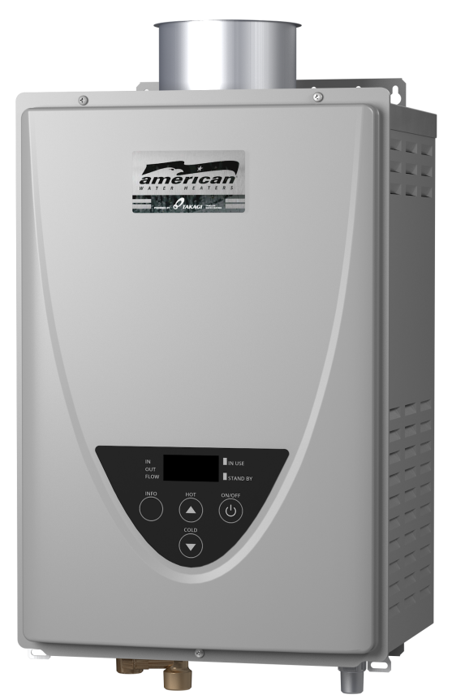
Features & Benefits
Gas conversion kit supplied with heater
New ultra-low NOx burner produces fewer emissions
0.82 EF
Certified for high altitude (10,100’)
Increased capacity (510C)
  Easy-link up to four heaters
    Linking cable supplied with heater
  Multi-link up to twenty heaters
    Multi-unit controller (9008300005)

Slide 6
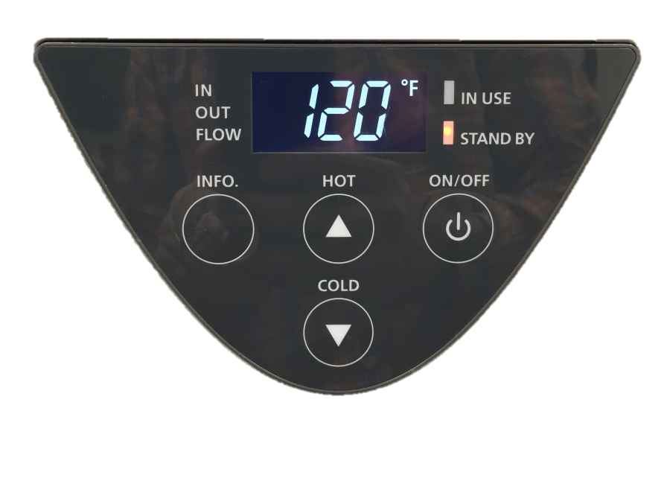
Features & Benefits
Integrated controls simplify temperature adjustments and troubleshooting
  100°F to 140°F in 5°F increments (110C, 310C)
  100°F to 160°F in 5°F increments (510C)
  Default set temperature is 120°F
Temperature lock feature
  To get above 120°F, press and hold “Hot” and “Info” buttons for 3 seconds
  To get above 140°F (510C), press and hold “Hot” and “Info” buttons for 3 seconds

Slide 7
Features & Benefits
Warranty (see installation manual for complete warranty details):
Application Type | Heat Exchanger | Parts | Labor
Single Family DHW | 15 years | 5 years | 1 years
Commercial or Multi-Family DHW | 10 years
Heating | 10 years

Slide 8
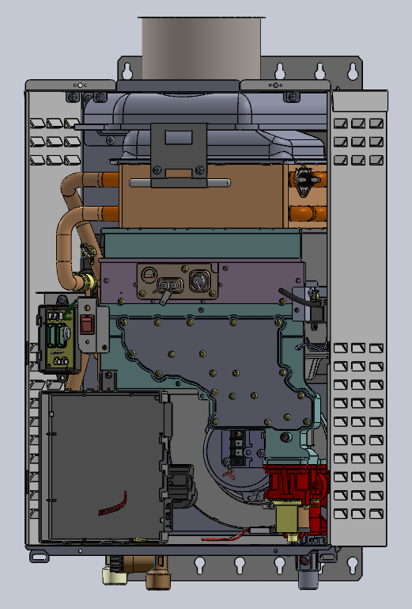
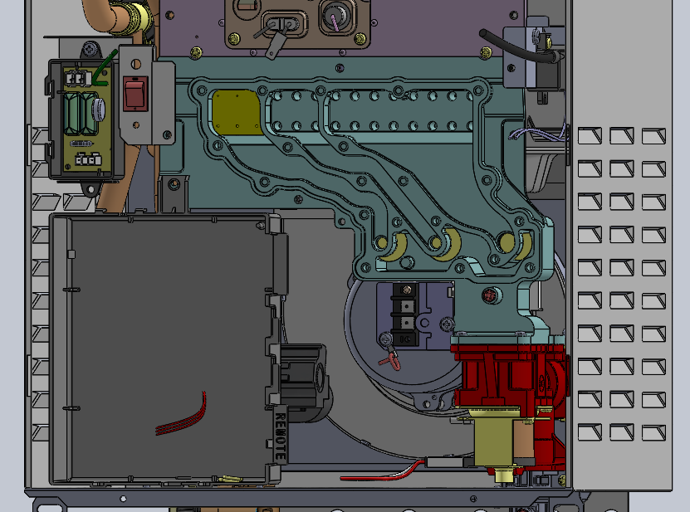
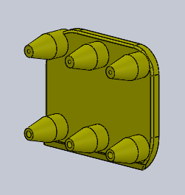
Gas Conversion
Remove screws
Remove cover
Insert manifold pieces
Replace cover
Install screws
Change dipswitch

Slide 9
Gas Conversion
Gas conversion kit
  Instruction sheet
  LP Gas manifold nozzles
  Manifold gasket
  Gas conversion label
QR Code is coming!
https://vimeo.com/hotwateru/review/150950178/06bb8f8445

Slide 10

Benefits of Gas Conversion
Reduce Distributor inventory complexity by 50%
“Small, Medium, Large”
Reduce mistakes
Increase product availability
Reduce slow moving inventory
Circulation of Capital
Purchase
Product
Reorder
Circulation of Capital
Inventory
Profit
Sell
Product

Slide 11
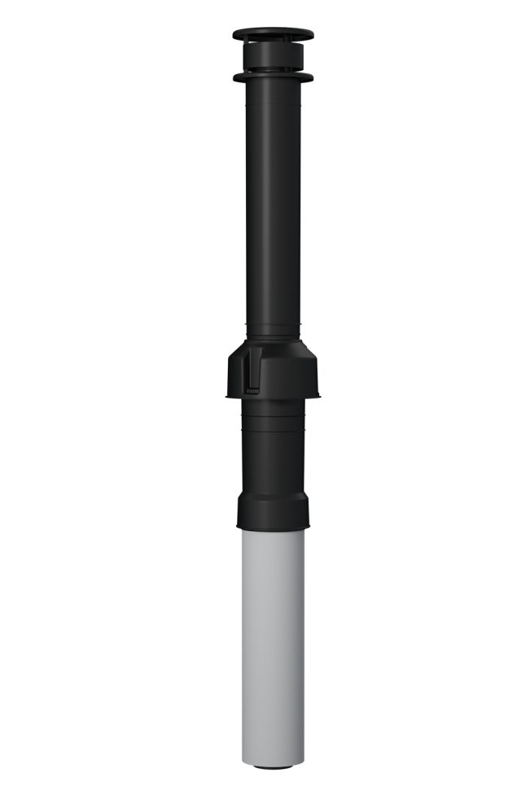
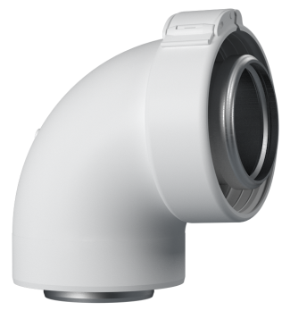
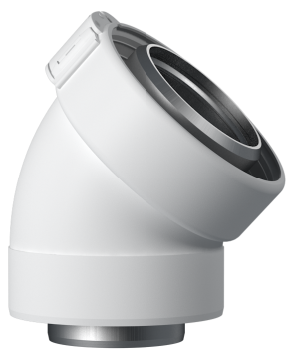
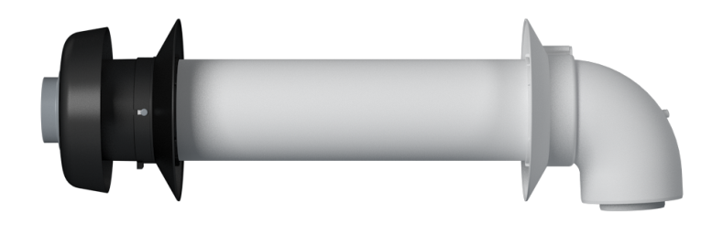
APNC35 Venting System
Horizontal & vertical installations
43’ max venting length
  4 elbows max
Part Number | Description
100266115 | 11.5" Standard Sidewall Kit
100266117 | 21" Standard Sidewall Kit
100266118 | 38" Roof termination
100266119 | 45 degree elbow
100266132 | 90 degree elbow
100266133 | 10" Straight pipe
100266134 | 19.5" Straight pipe
100266135 | 39" Straight pipe
100266187 | Flat roof flashing
100266136 | Tile/Shingle roof flashing 1/12 to 6/12 pitch
100266137 | Tile/Shingle roof flashing 8/12 to 16/12 pitch
100266138 | Tile/Shingle roof flashing 6/12 to 12/12 pitch
100266139 | Condensate trap
100266140 | Condensate collector
100266141 | Pipe hangers
9007604005 | Isolation valve kit
9008871005 | Product Preserver - anti-scale filter kit
9009069005 | Remote controller
9008300005 | Multi-unit controller (510C only)

Slide 12
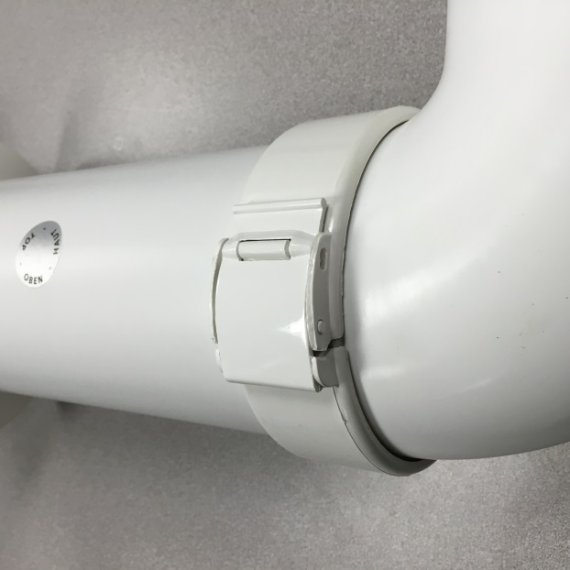
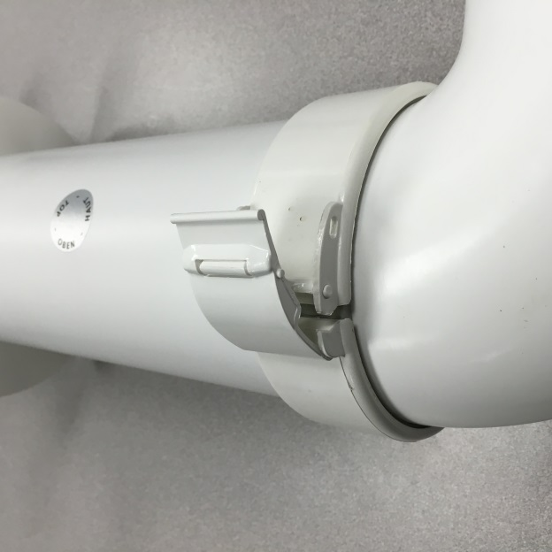
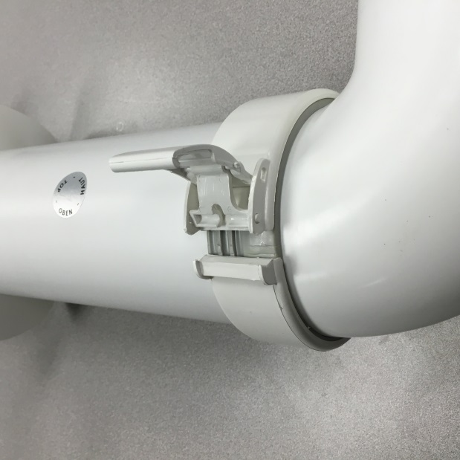
Venting is a “snap”
Notes:
Female Ends have locking collars with Gaskets. Unlock the collar and slide a male end into the female end. The inside of both intake and exhaust pipes on the female end have gaskets that will seal to the male ends. Once inserted, lock the collar to secure the two pipe sections.

Slide 13
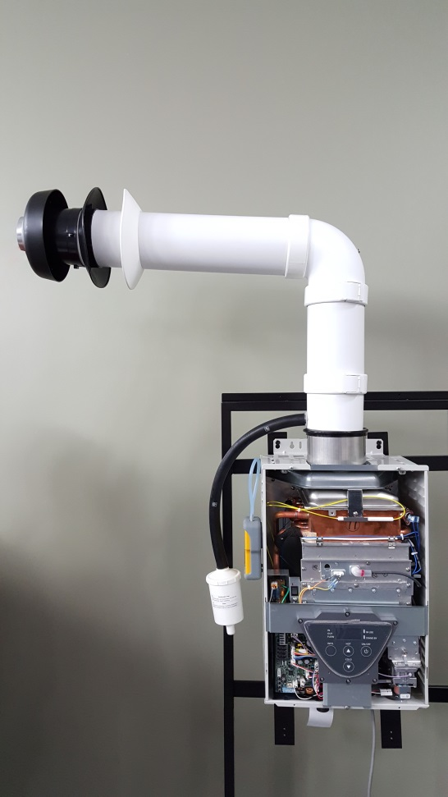
APNC35 Venting
Condensate Collector
  Not required if termination is directly off the top of the heater
Condensate Trap
  Required with Condensate Collector
Termination
  Horizontal termination cannot be used in vertical application.
  Different part for vertical termination.
3
1
2

Slide 14
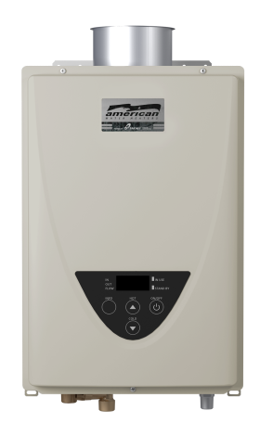
Marketplace Summary
 | State | Rinnai | Rheem | Noritz
EF | 0.82 | 0.82 | 0.82 | 0.82
Venting | Centrotherm | Ubbink | Metal Fab, Inc. | N-vent (Tosetz)
Gas Convertibility | Yes | No | No | No
Easy-link | 4 | 2 | 2 | 2
Warranty (yrs) | 15 | 12 | 12 | 12

